Slide 1
Control Board to Cryo Board Cable

Slide 2
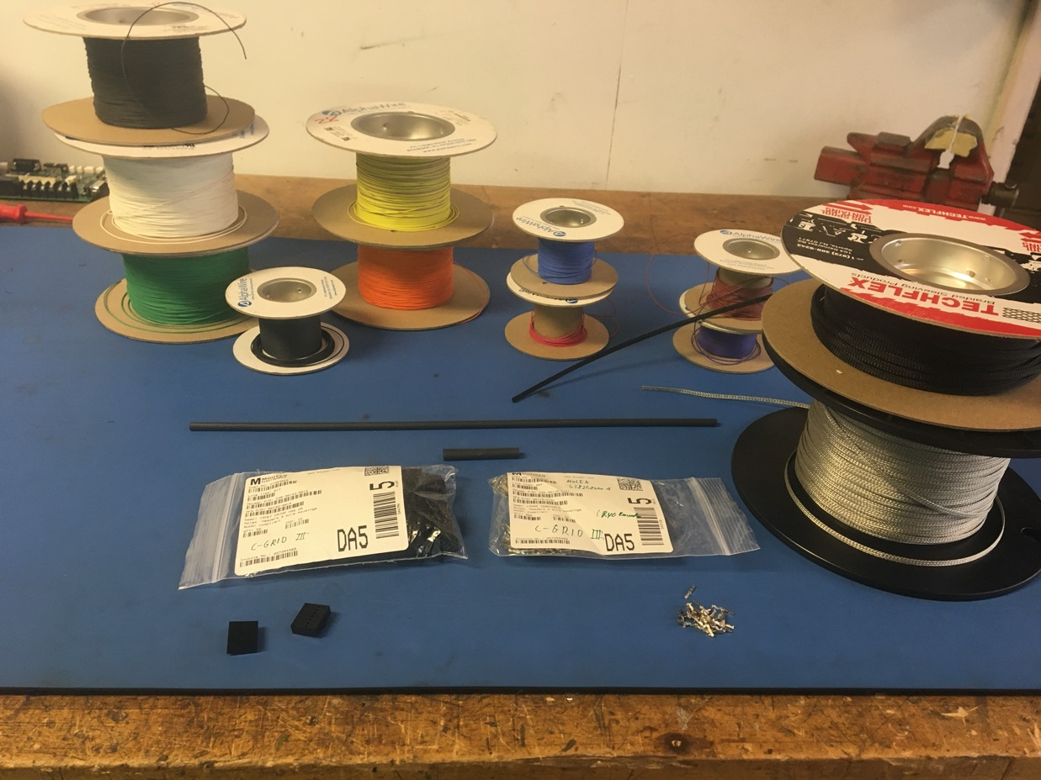
Materials

Slide 3
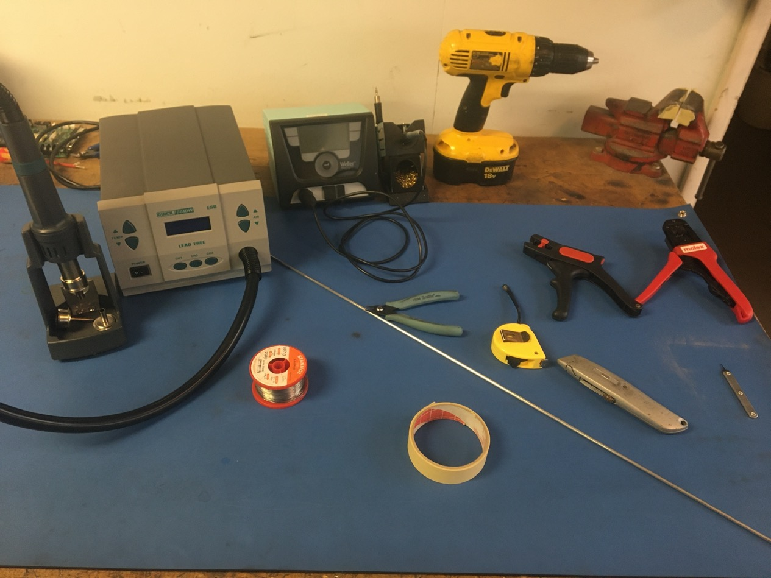
Tools

Slide 4
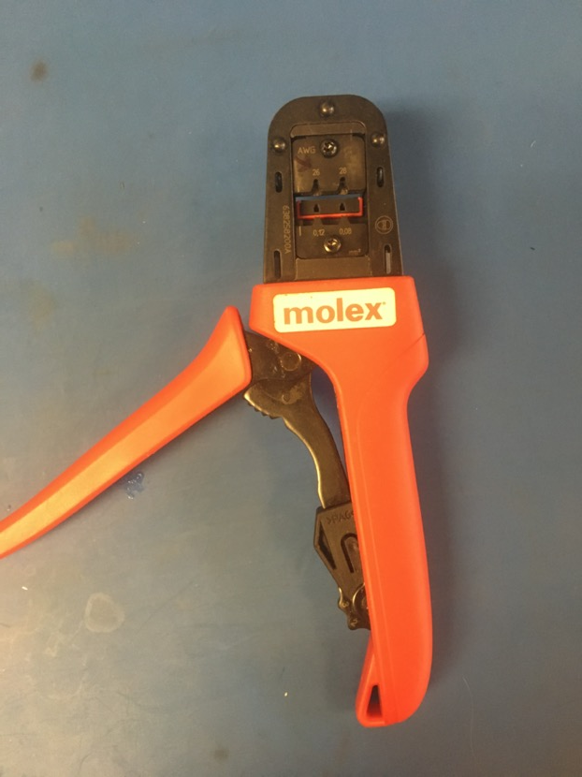
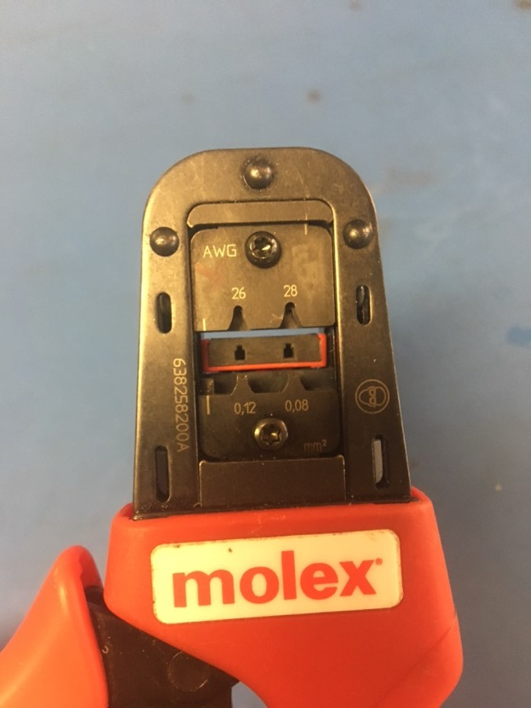
C Grid III Crimper

Slide 5
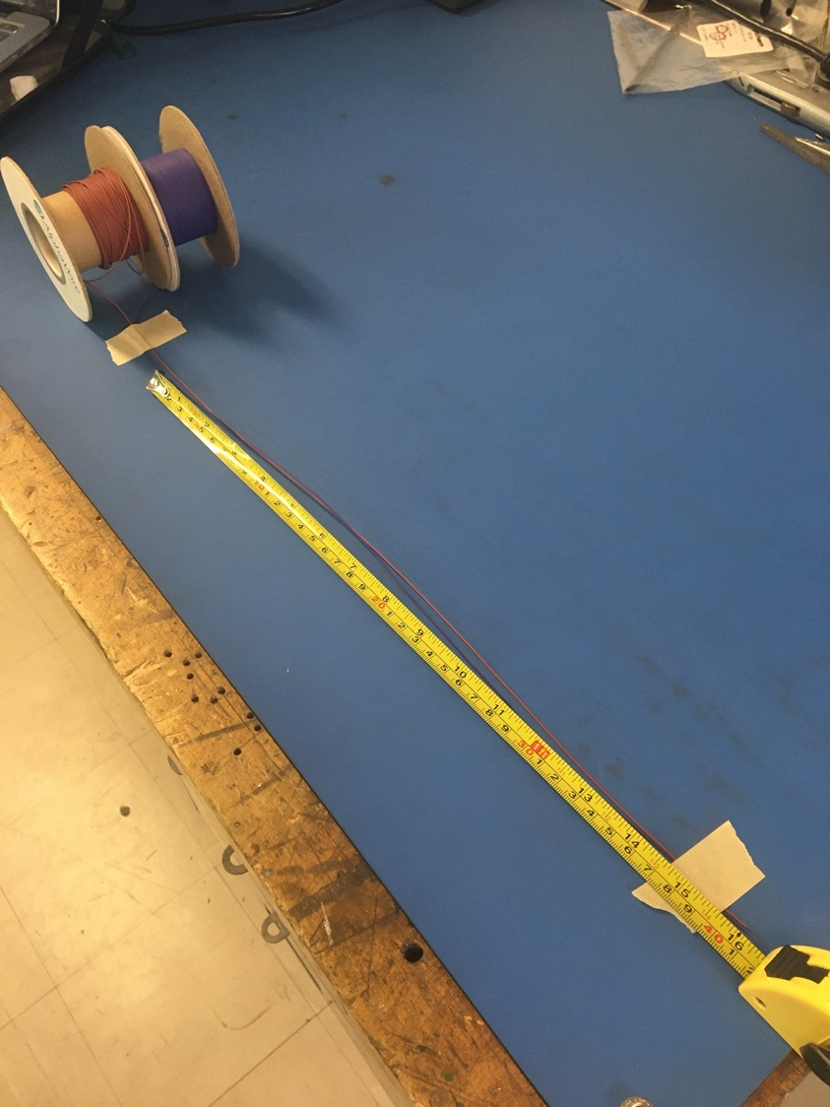
Measure out and cut 16 inches of brown, violet, yellow, orange, black, red, white, green, and blue 28 awg wire.

Slide 6
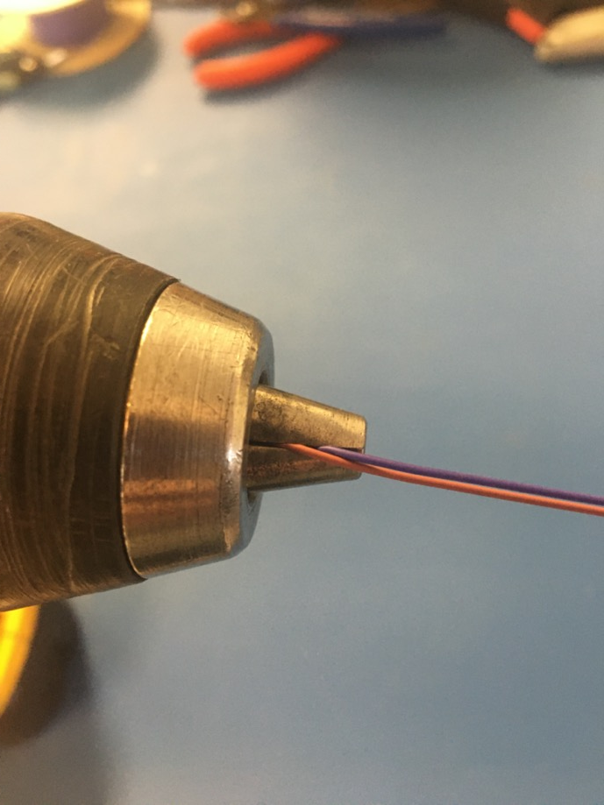
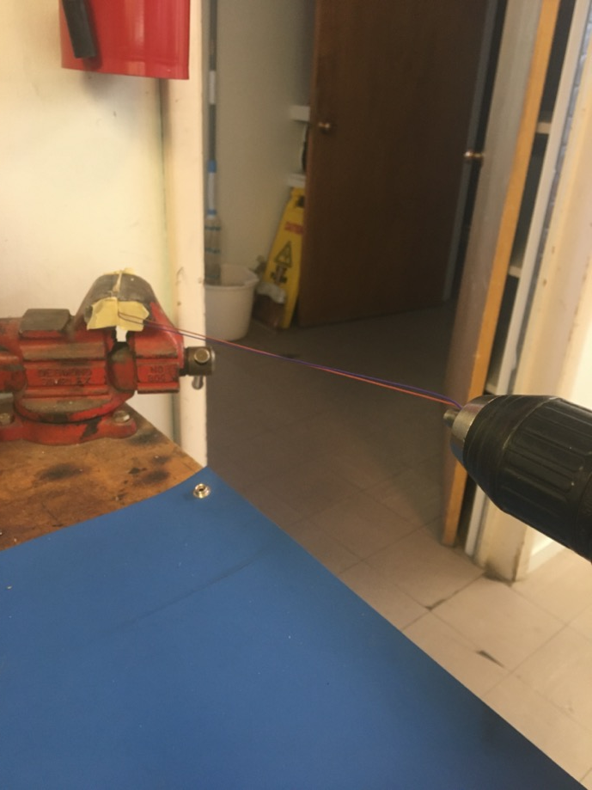
To make the twisted pairs/triplets, line the vise with masking tape. Put one end of the brown and violet wires into the drill. Run the drill till the wires are sufficiently twisted (for reference see the next slide). Repeat with the wrest of the wires. The wrest of the pairs/triplets should be orange/yellow, red/black, and white/green/blue.

Slide 7
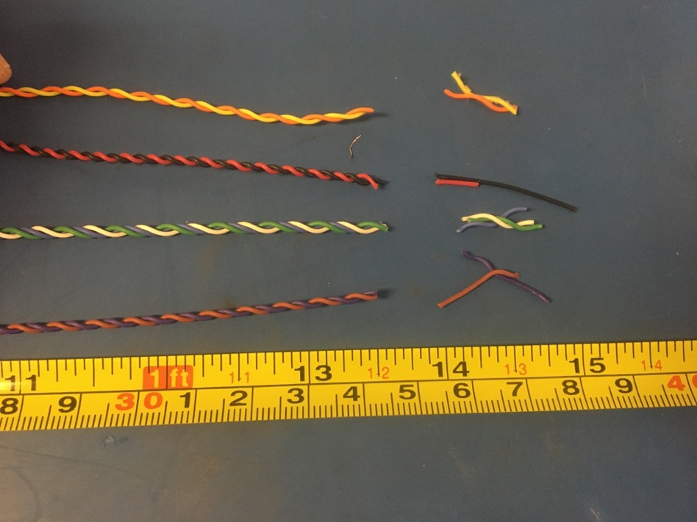
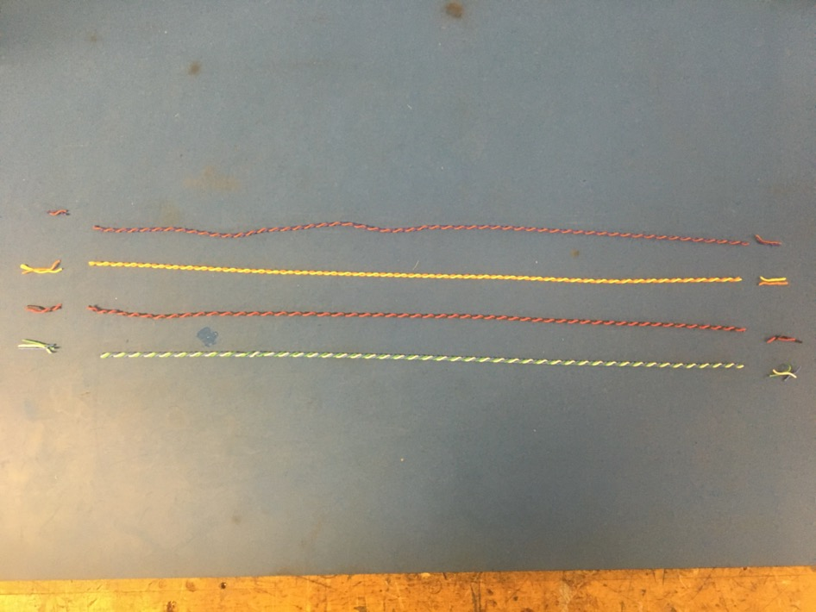
Trim the ends of each twisted pair/triplet where they were in the vise and drill. Once trimmed they should measure about 13.5 inches.

Slide 8
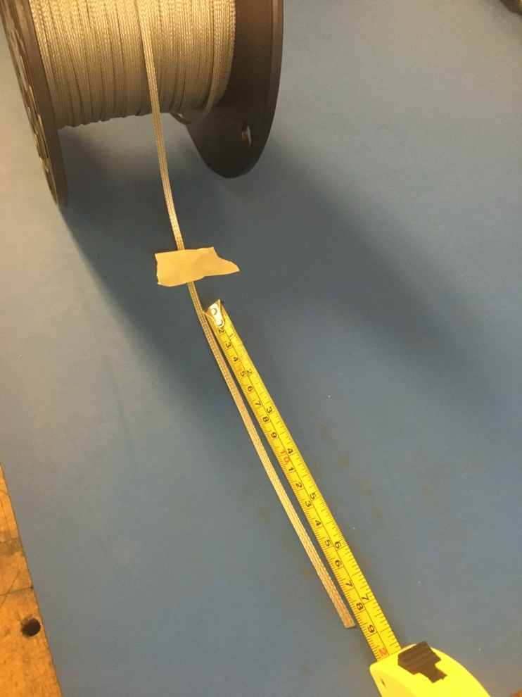
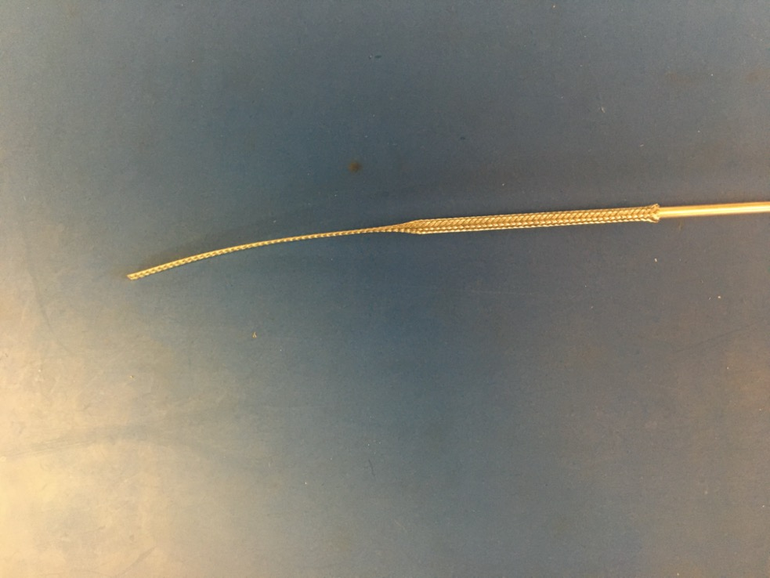
Measure out 7.25 inches of the 1/8th metal braid. Expand it using the metal rod.

Slide 9
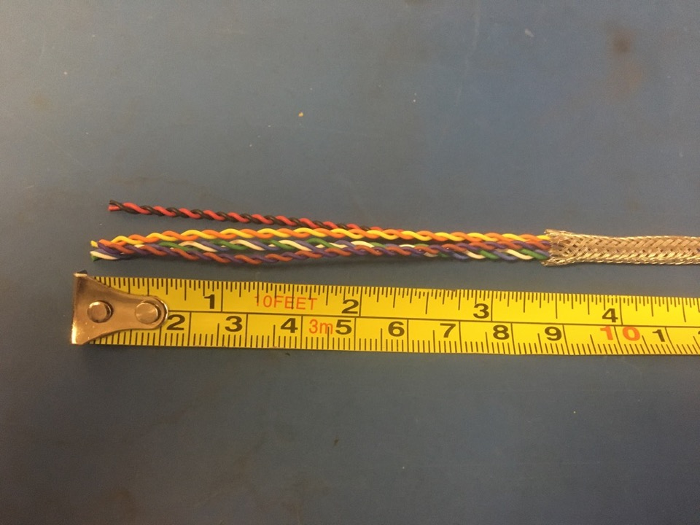
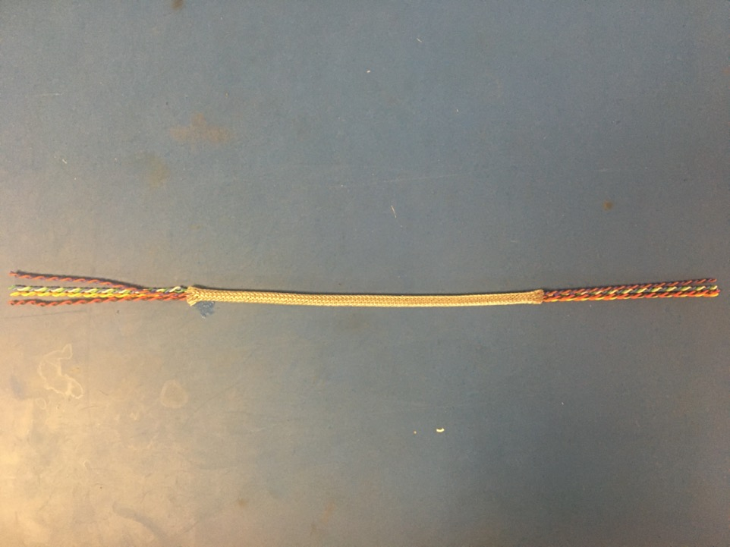
Put the twisted wires into the expanded metal braid. 3.5 inches of the twisted wires should stick out from the metal braid on one end.

Slide 10
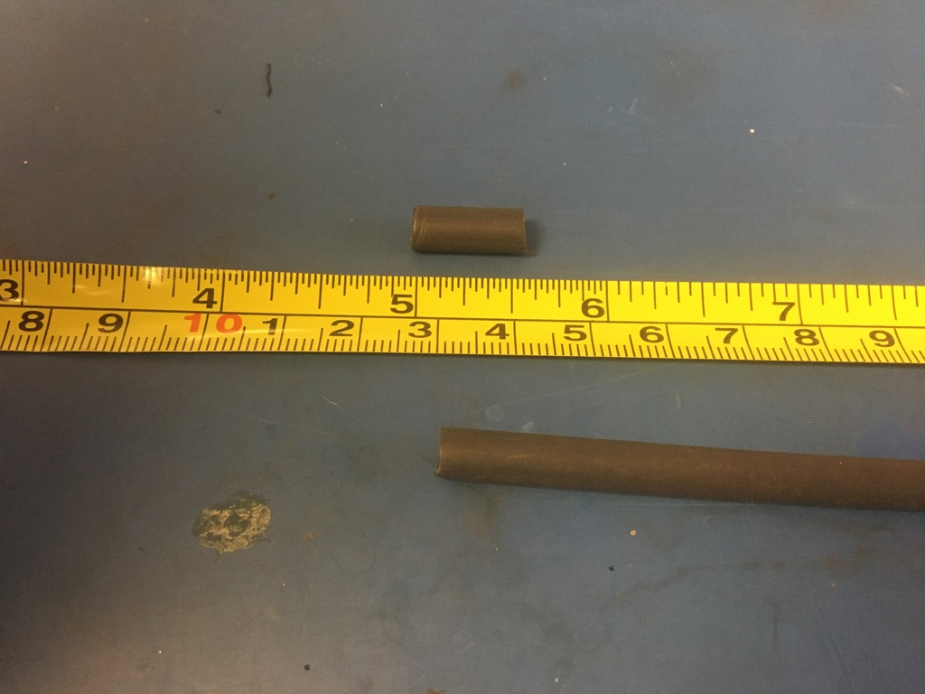
Measure out and cut two lengths of 4.8mm adhesive shrink tube each .5in long.

Slide 11
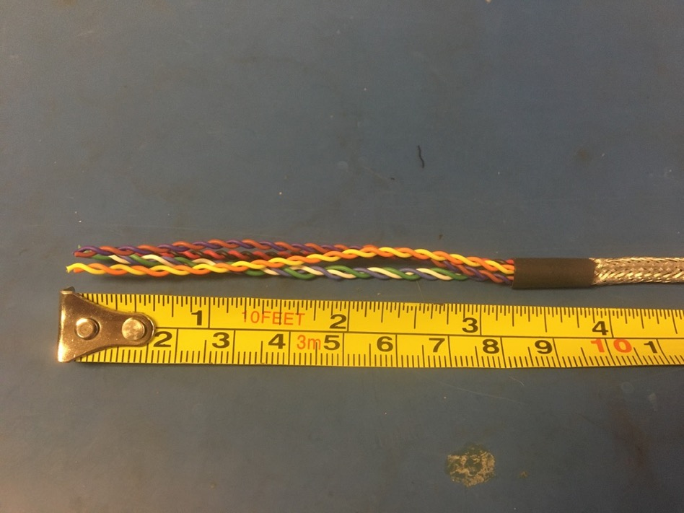
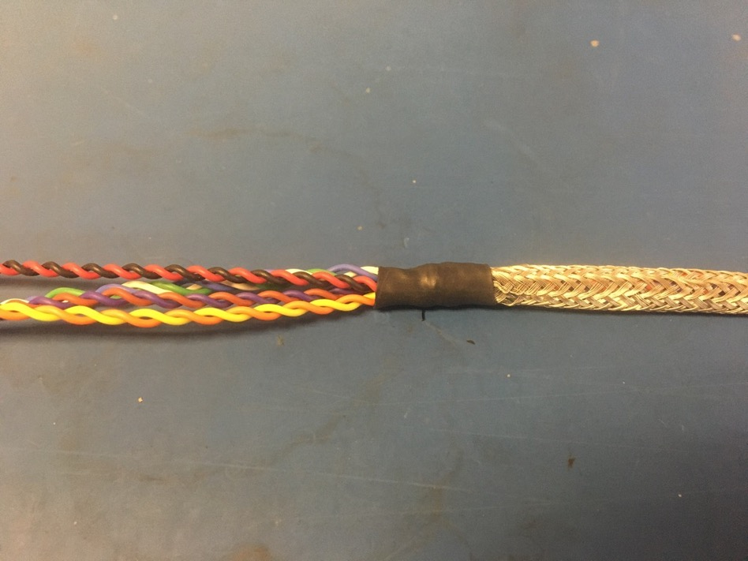
Put one of the pieces of the shrink tube onto the end of the metal braid where the wires measured 3.5 inches. Place the shrink tube such that the metal braid ends midway through it. The wires should now measure 3.25 inches. Apply the heat gun to the shrink tube.

Slide 12
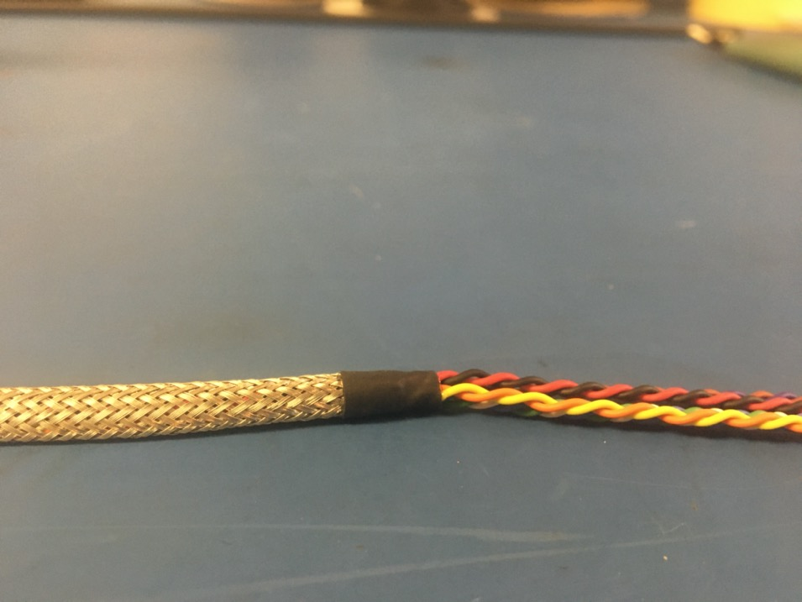
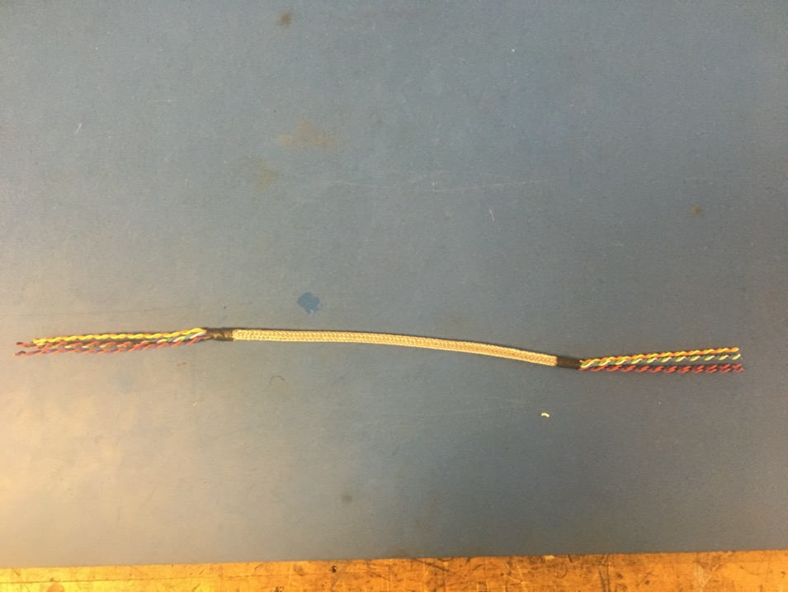
Repeat the process on the previous slide on the other end of the metal braid (though the wire does not need to be measured this time). Thus far, the wire harness should appear as shown on the right.

Slide 13
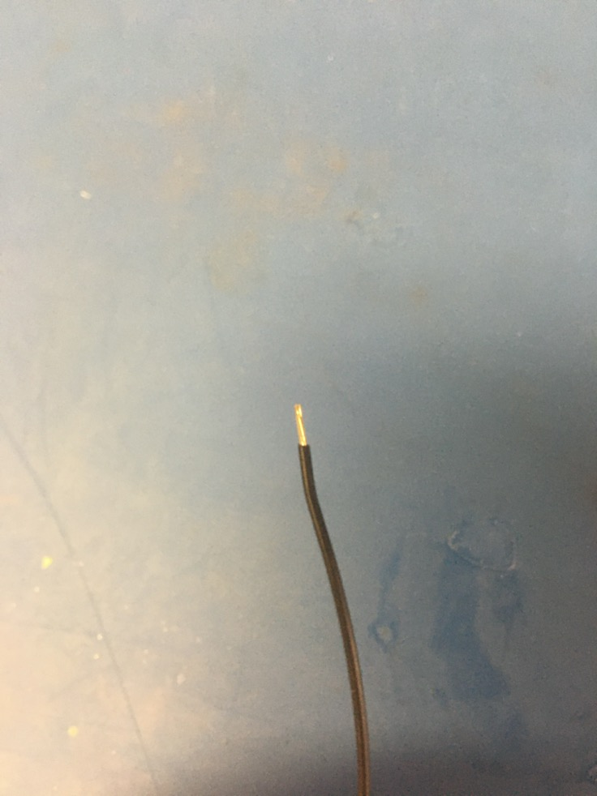
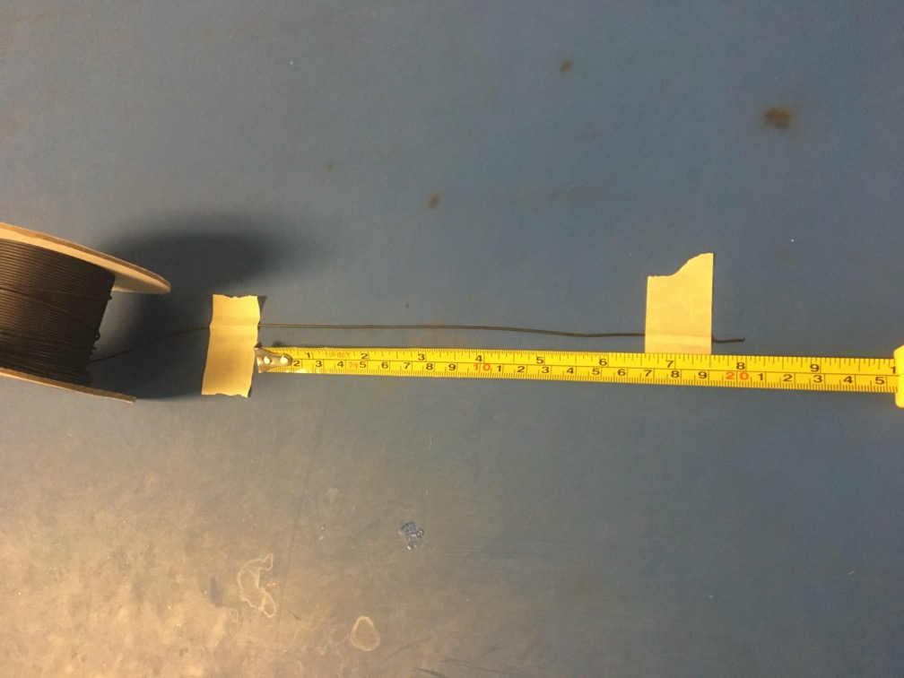
Measure out and cut 8 inches of black 24 awg wires. Strip 3-4mm off one end.

Slide 14
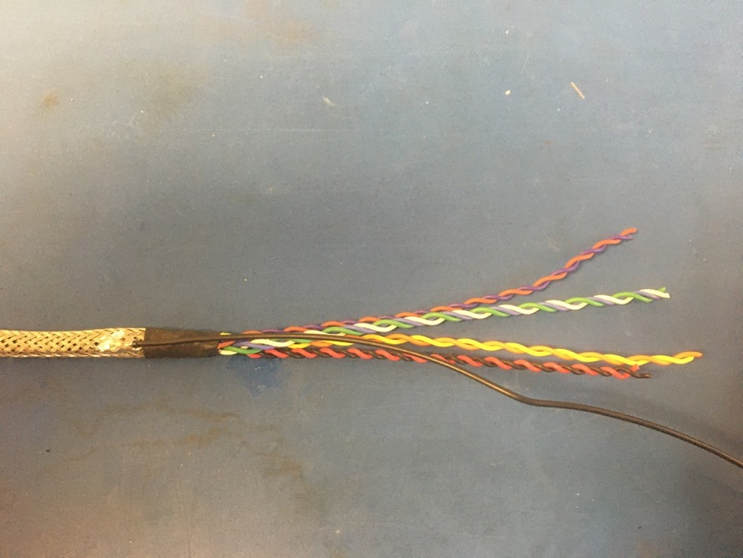
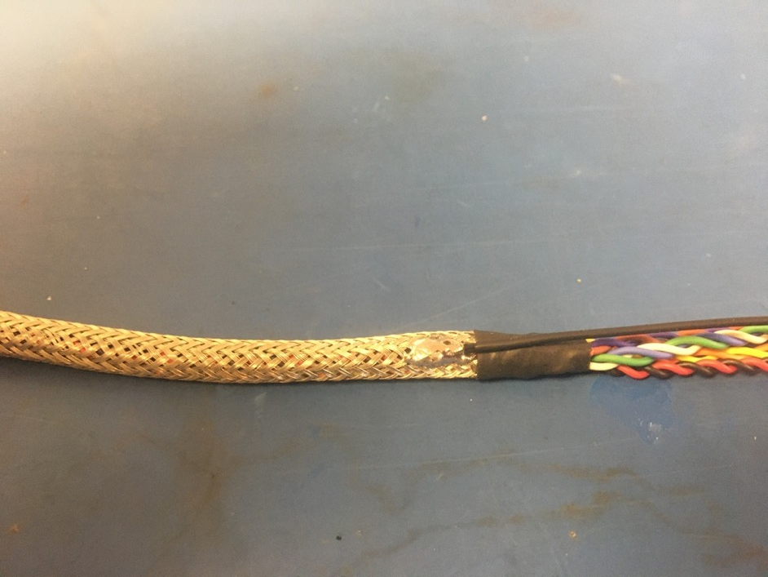
Solder the stripped end of the black wire onto the metal braid near one of the shrink tube joints. It does not matter which end. The black wire should be soldered so the that the length of it runs toward the shrink tube joint its soldered next to.

Slide 15
Measure out and cut 6.75 inches of 1/4th plastic braid.
6.75in

Slide 16
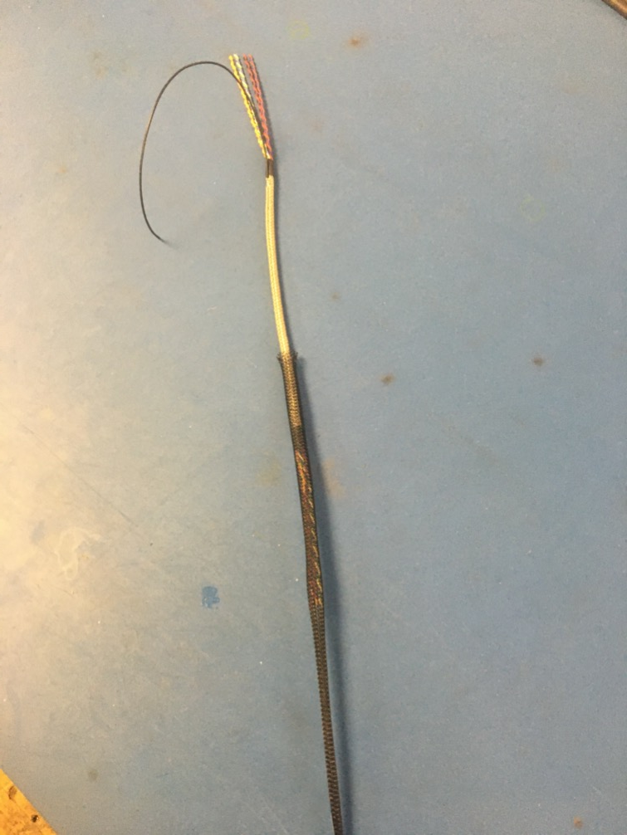
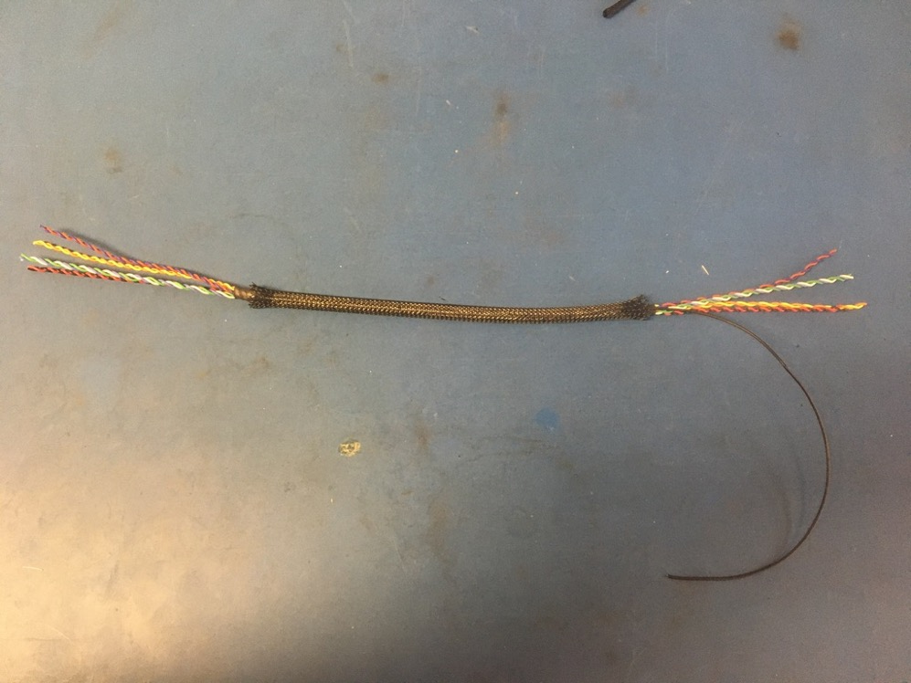
Put the plastic braid onto the wire harness. It is easier it put it on from the end without the ground wire. The plastic braid should be placed such that both ends land midway through the metal braid shrink tube joints.

Slide 17
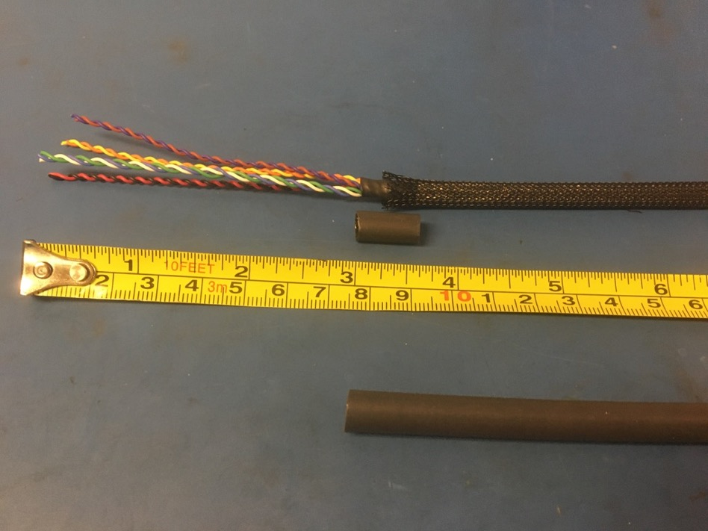
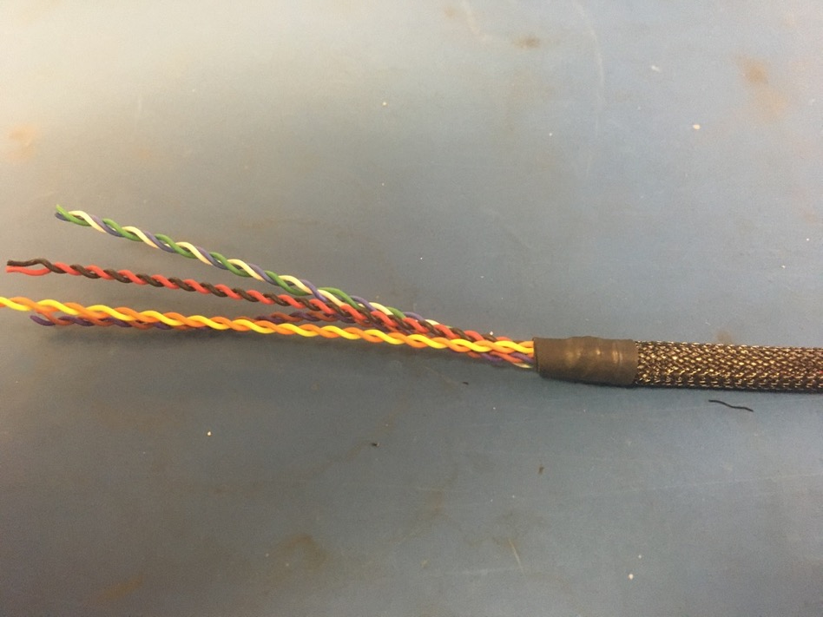
Measure out and cut one length of 6.4mm adhesive shrink tube that is .5in long. Place the piece of shrink tube onto the plastic braid end without the ground wire. The plastic braid should end midway through the piece of shrink tube. Apply the heat gun.

Slide 18
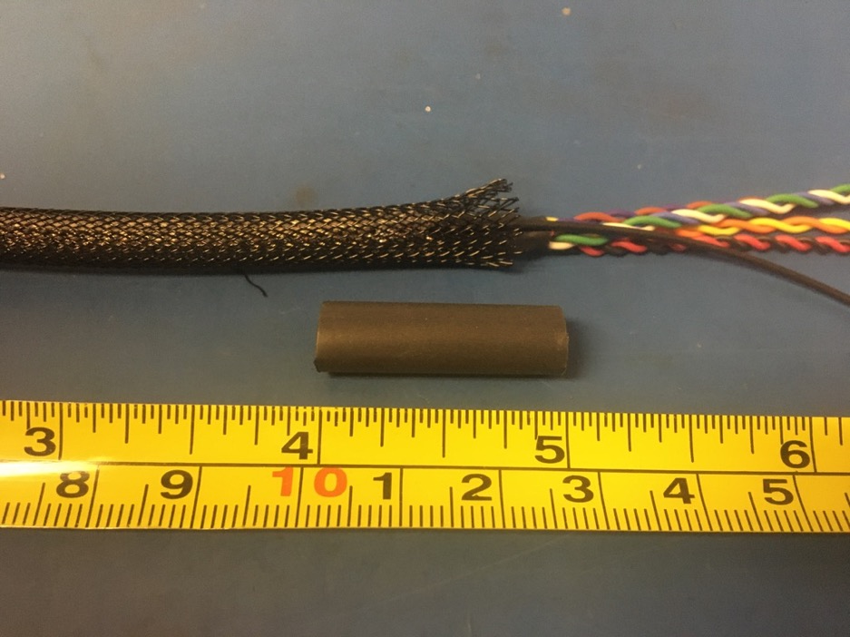
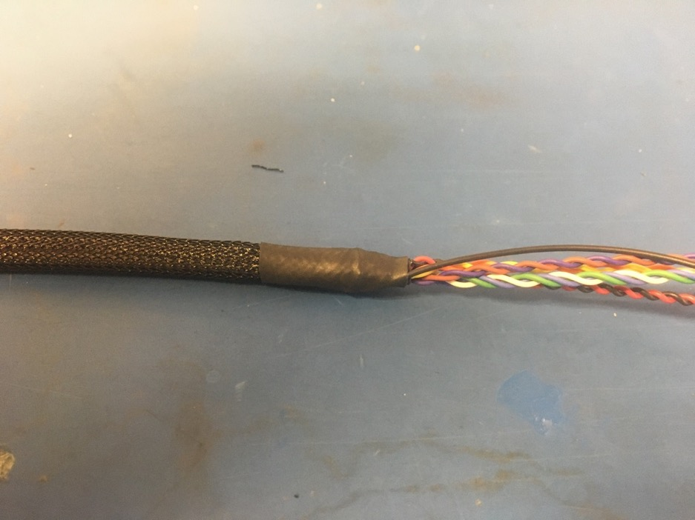
Measure out and cut one length of 6.4mm adhesive shrink tube that is 1in long. Place the piece of shrink tube onto the other end of the plastic braid (the ground wire end). The shrink tube should be placed such that it covers the solder joint and the length of the metal braid shrink tube. Apply the heat gun.

Slide 19
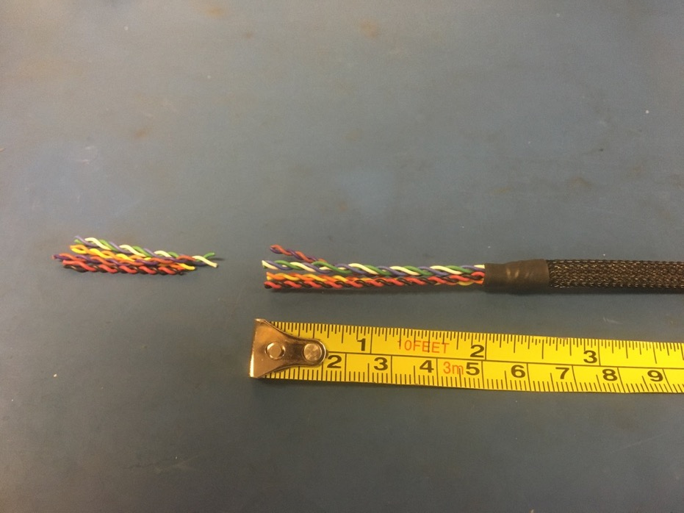
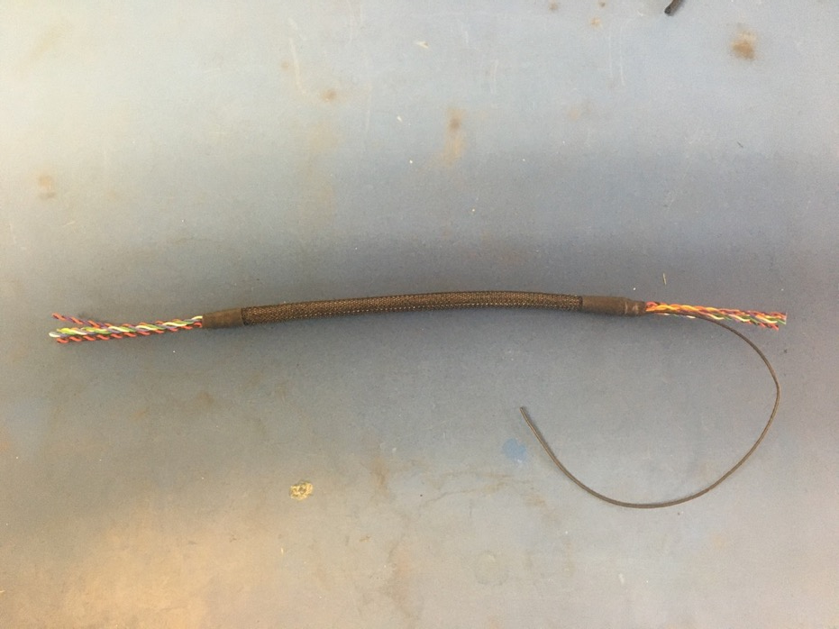
Measure and cut each end of the twisted wires so that they measure 2 inches.

Slide 20
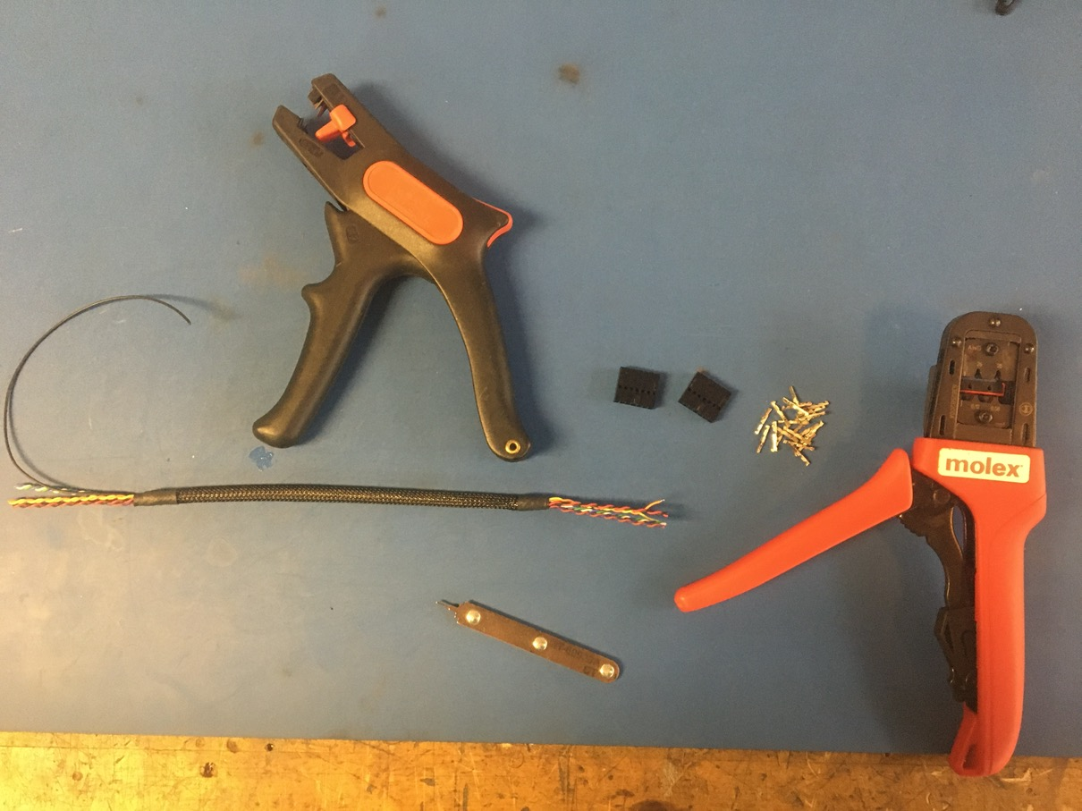
The harness is now ready for crimping and connectors. Below is what is needed for this process.

Slide 21
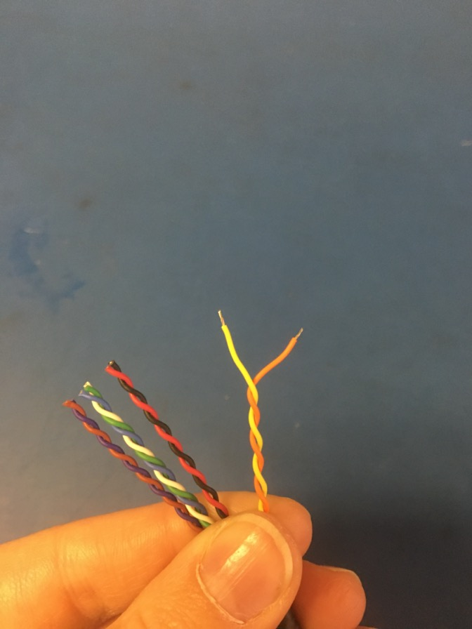
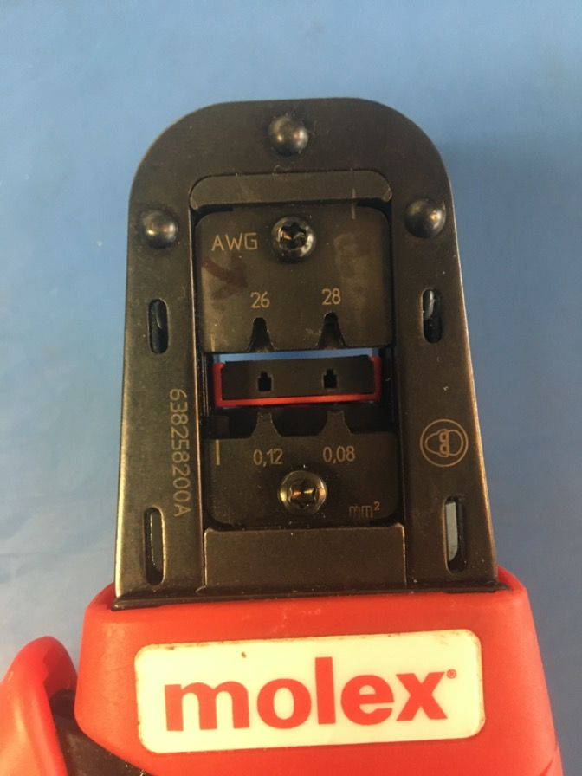
Strip 2-3mm off each wire in the twisted pairs/triplets. Crimp the C Grid III tips on using the 26 awg hole on the crimper.

Slide 22
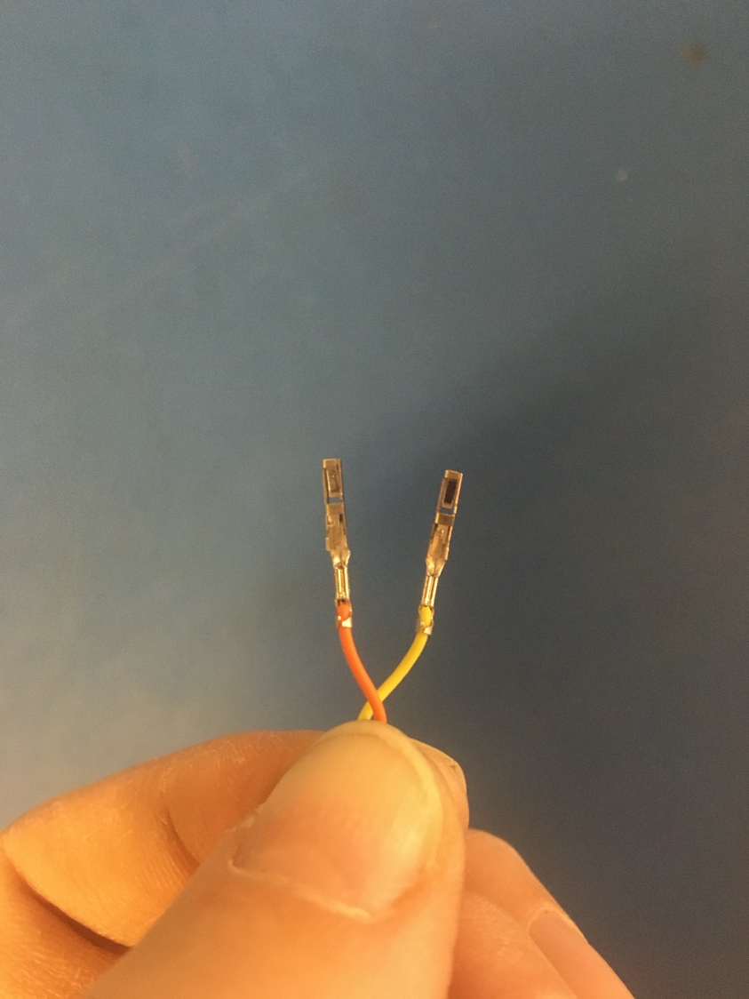
Crimp on the tips such that the isolation is held by the first grip of the tip but not the second. A bit of exposed wire should also be peaking out of the top of the second grip.
Exposed wire just visible
Isolation in first grip

Slide 23
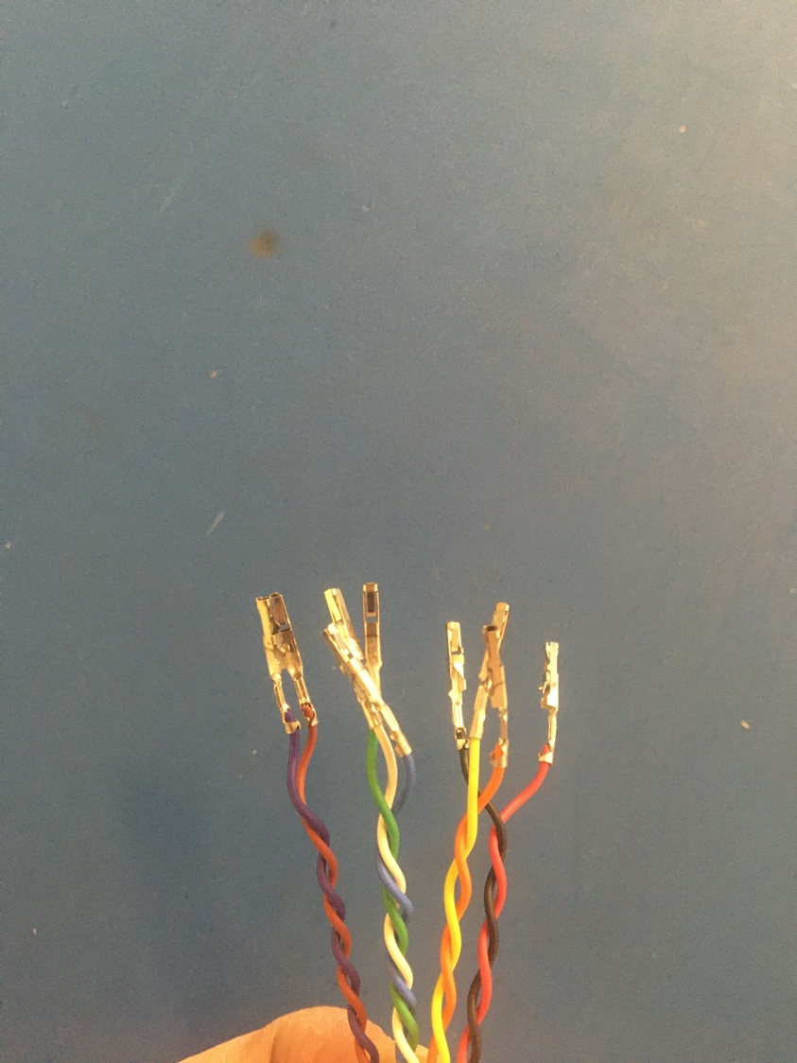
Crimp tips onto all the wires in the twisted pairs/triplets.

Slide 24
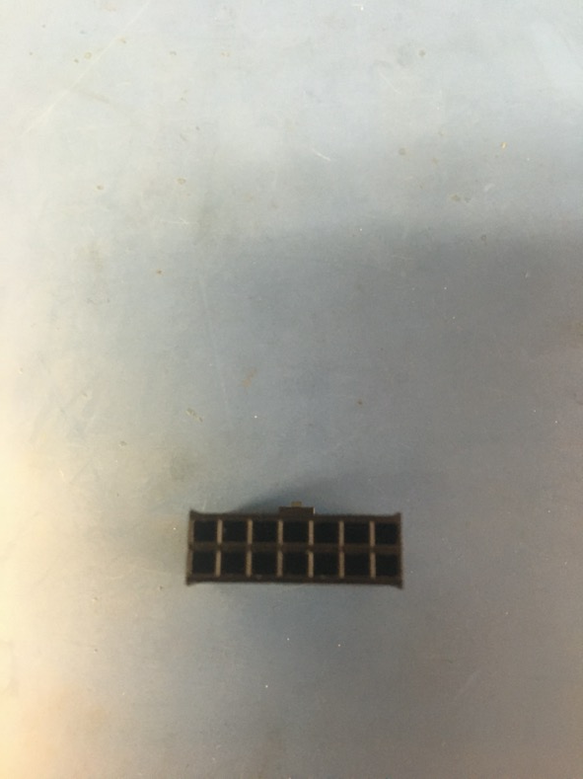
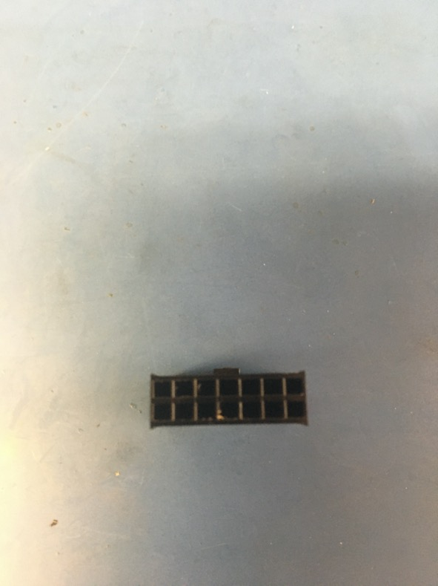
Take ONE of the C Grid III connectors and remove the lock tab using a razor blade or box cutter. This connector will be used on the end of the harness WITHOUT the ground wire.

Slide 25
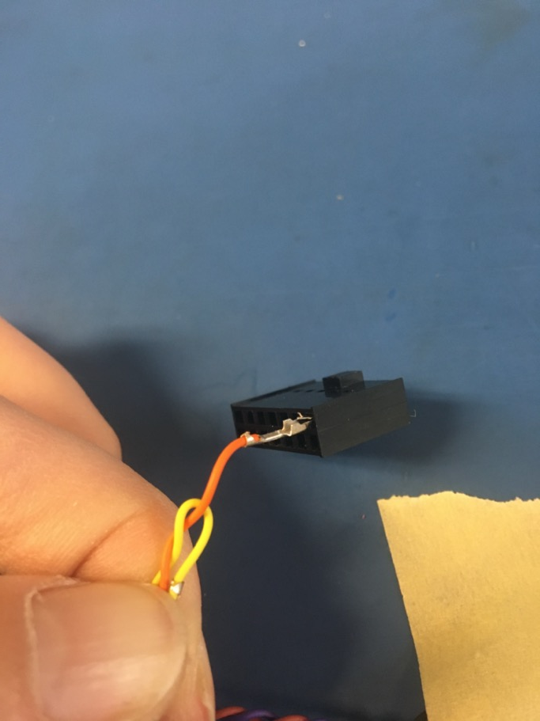
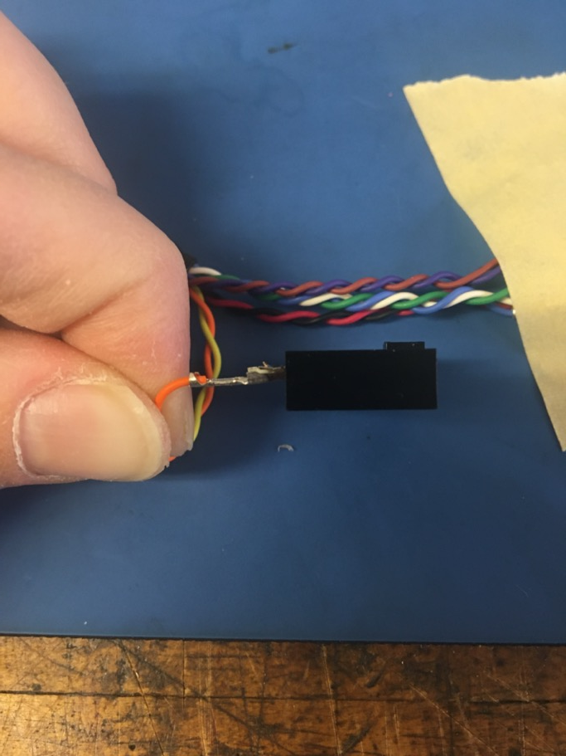
Insert the crimped wires into the connector. Please refer to the accompanying pin out document to see where each wire goes. For the wires in the top row, they should be inserted into the connector as shown below: with the grips facing up. The tip will click once it is in the connector completely. If there is difficulty in this process, use the metal insertion tool to push the tip in (shown on next slide).

Slide 26
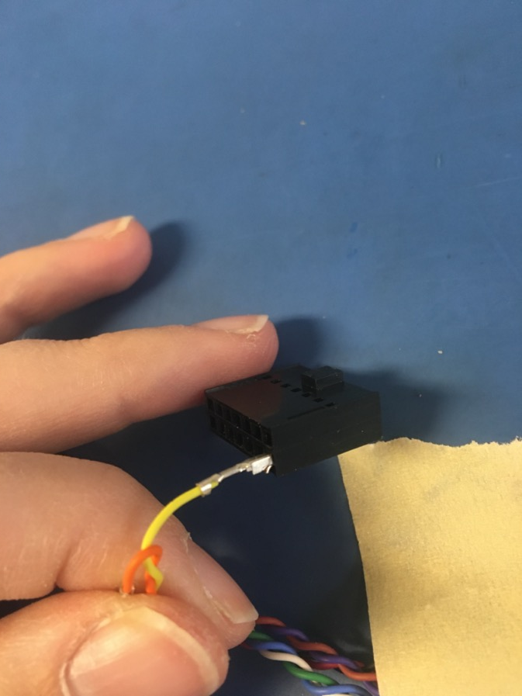
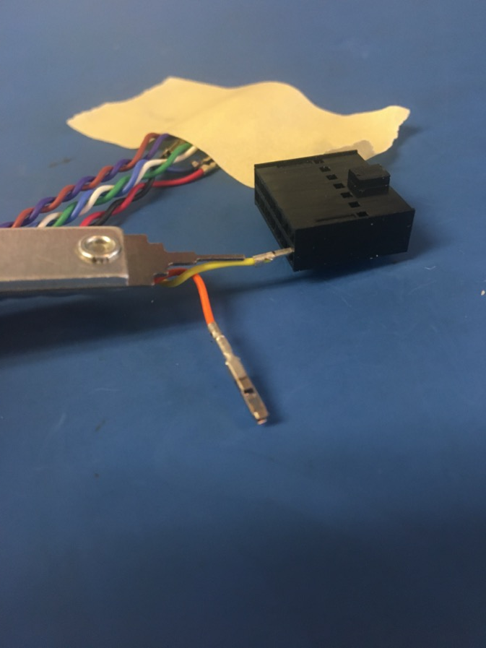
For the wires in the bottom row, the tips should be inserted with the grips facing down. The photo on the left shows how to push a tip into the connector with the insertion tool if a tip does not go in easily.

Slide 27
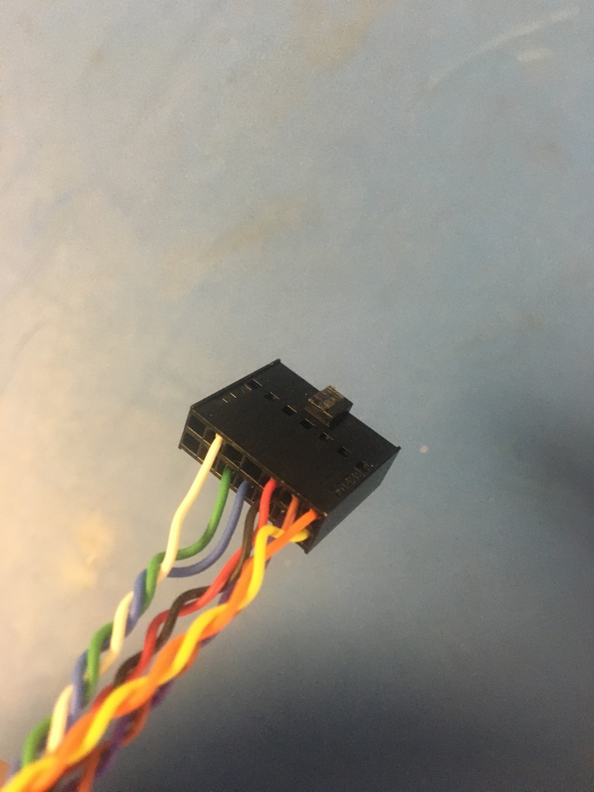
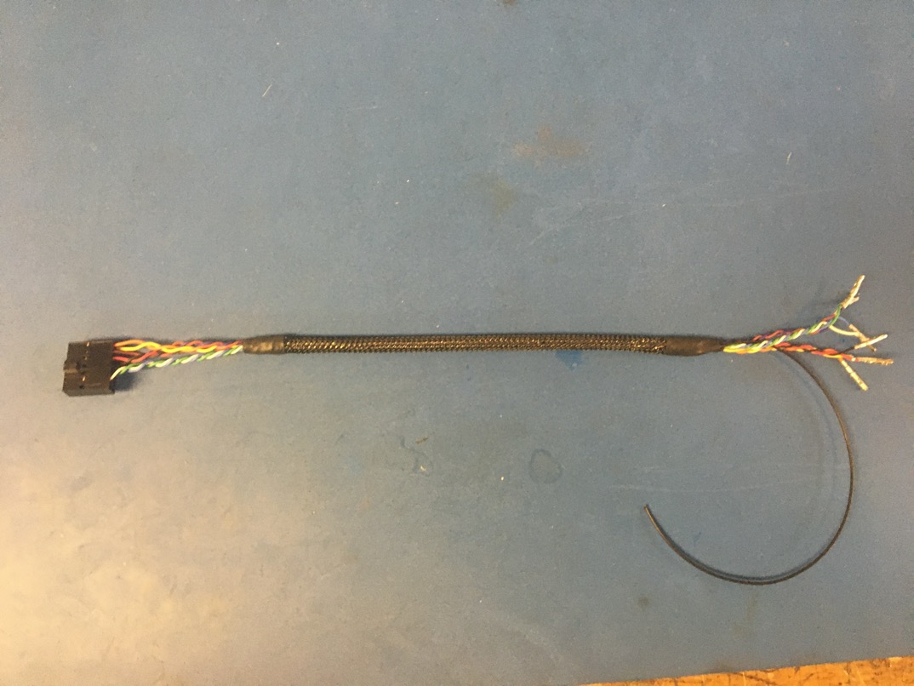
Once all the wires are inserted, the connector should appear as shown on the left. Insert the tips on the other end of the harness into the remaining connector. Remember that connector shown on the left is the one with the lock tab trimmed (on the end WITHOUT the ground wire) and so the other connector will NOT appear exactly as this one.

Slide 28
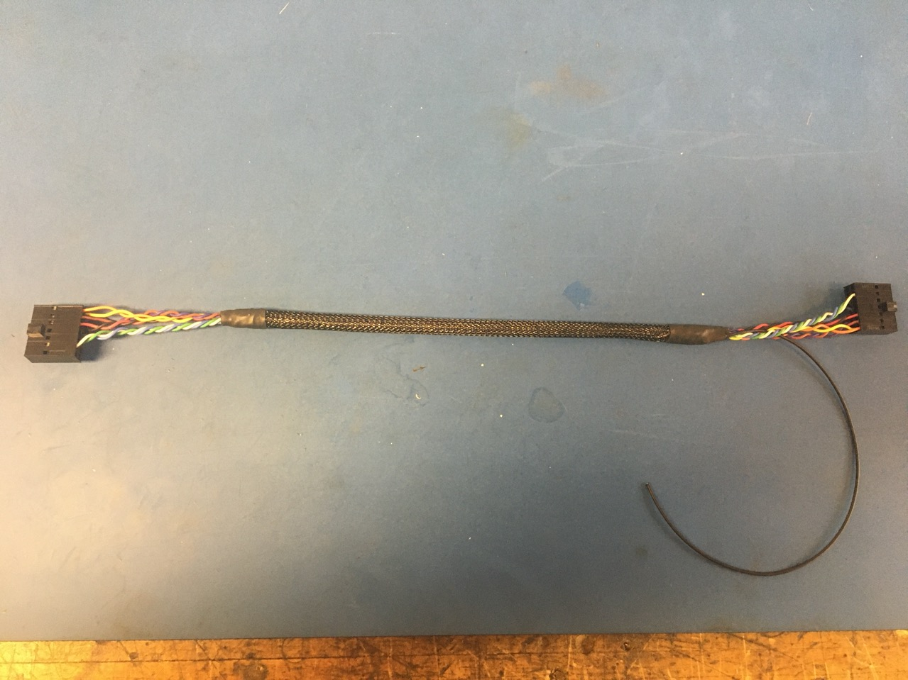
Wire harness complete! The ground wire will be given a tip later.

